Slide 1

POWDER Oscar Dowson Supervisors Andy Philpott, Andrew Mason, Anthony Downward

Slide 2
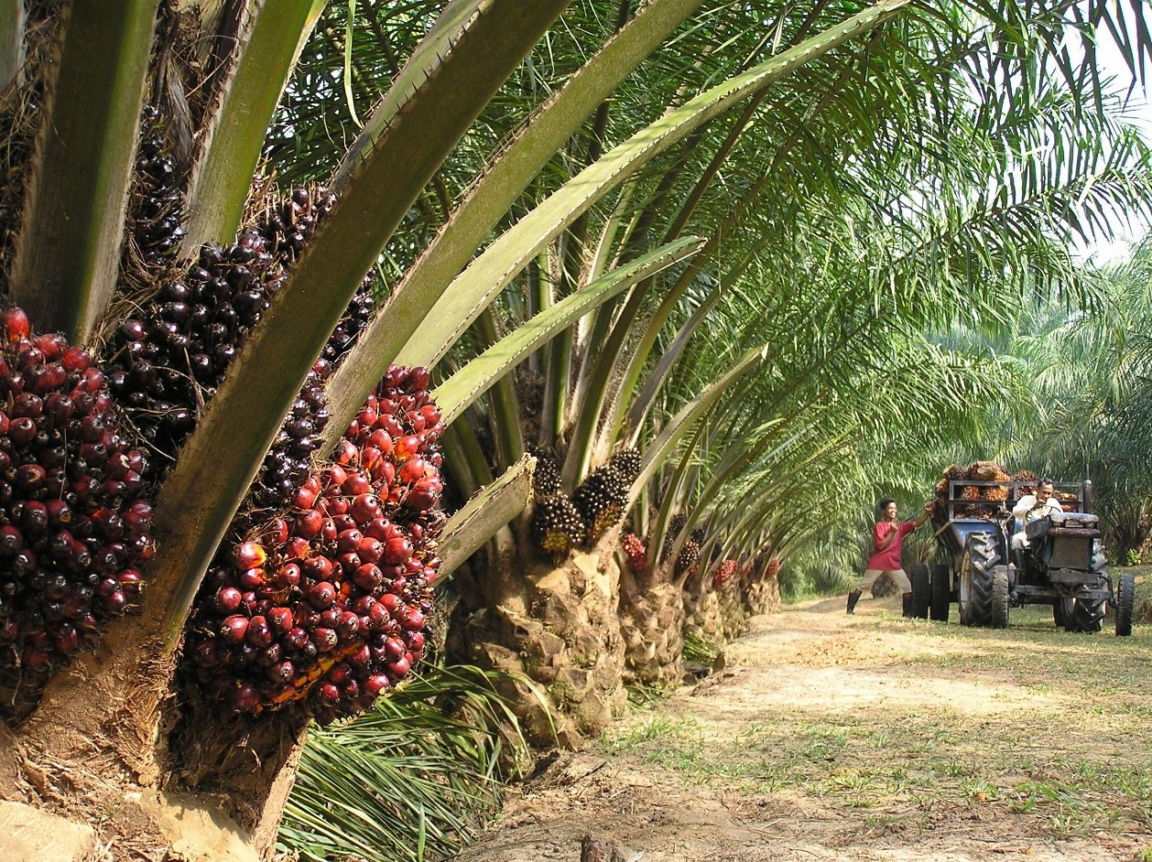
https://mylankaproperty.com/oil-palm-plantations/

Slide 3
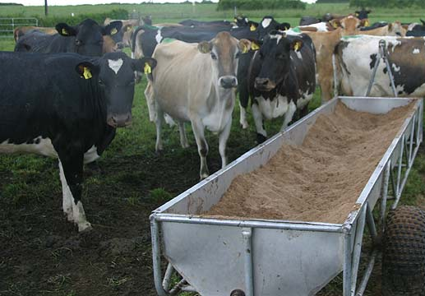
http://www.stuff.co.nz/business/farming/agribusiness/9255467/New-regime-awaits-palm-kernel-imports

Slide 4
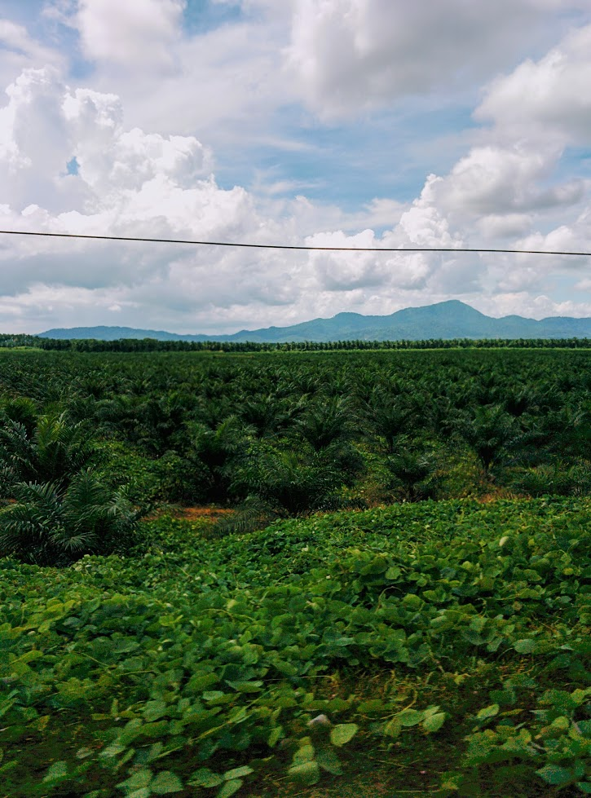
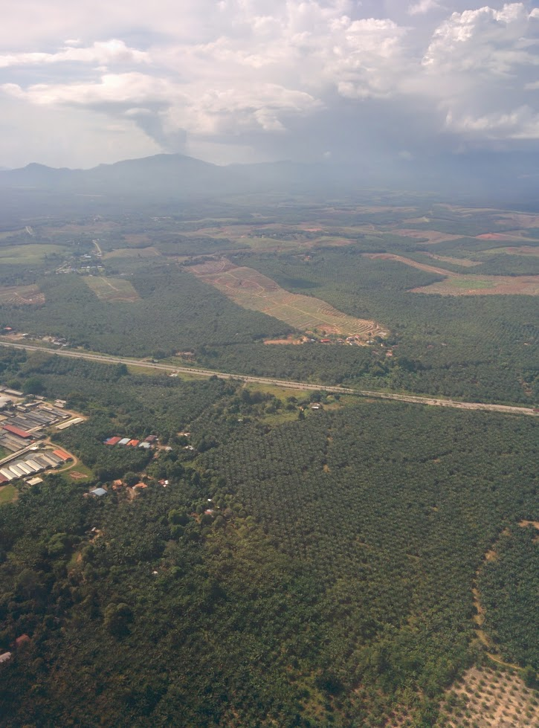

Slide 5
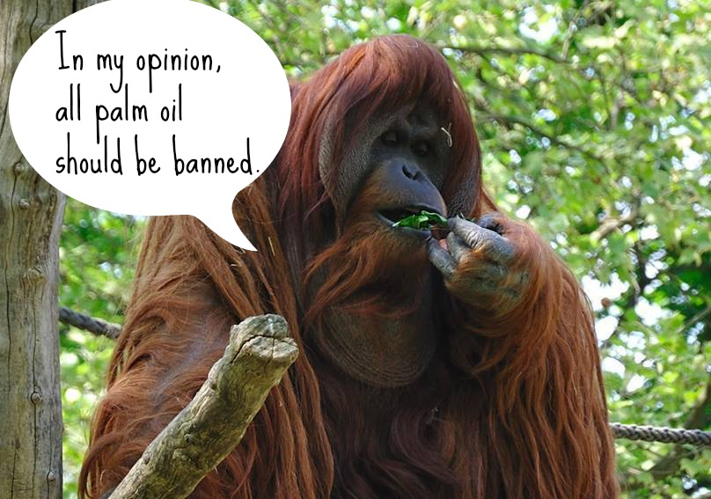
http://www.onegreenplanet.org/animalsandnature/outstanding-organizations-working-to-save-endangered-orangutans/

Slide 6
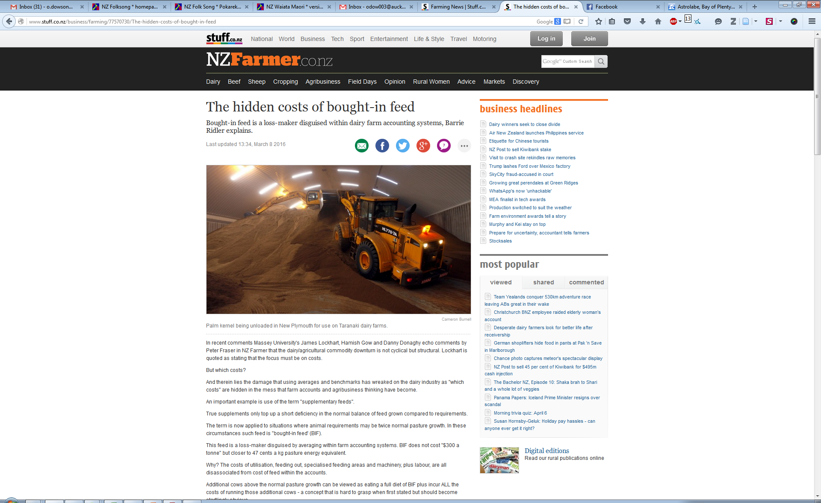
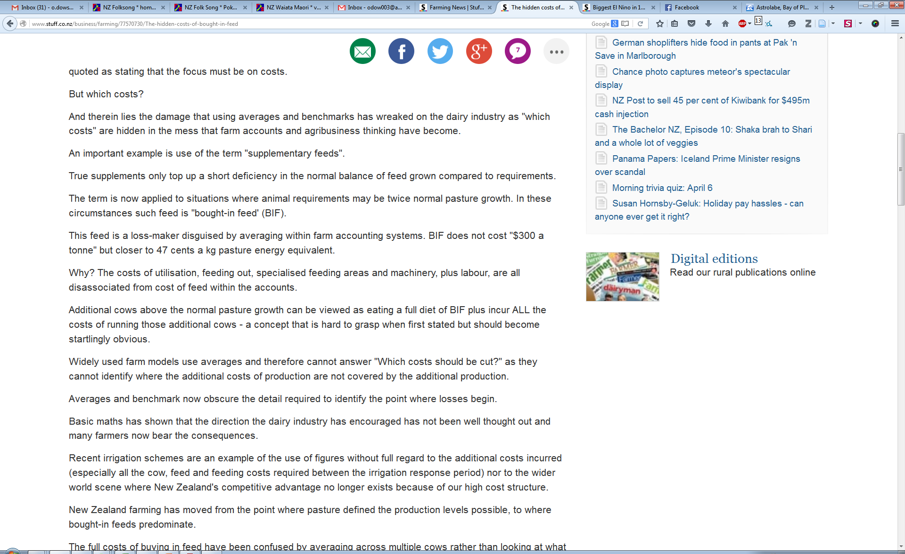

Slide 7
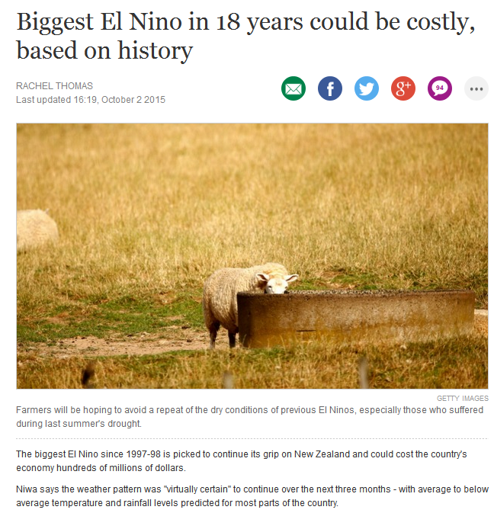

Slide 8
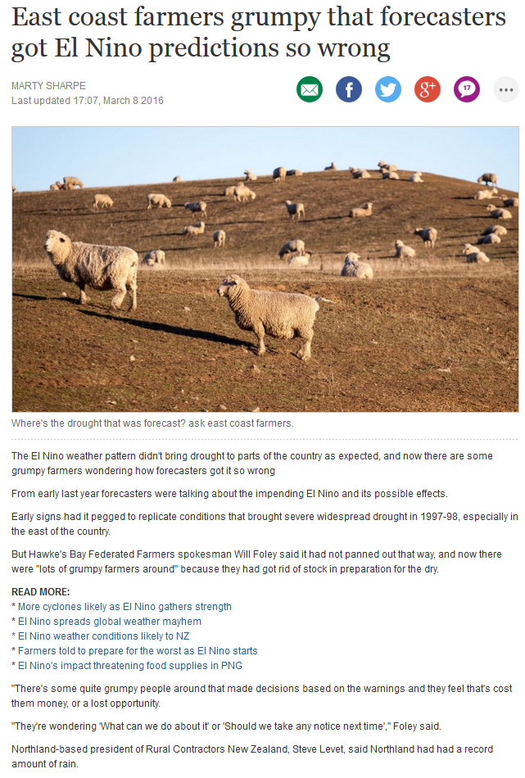

Slide 9
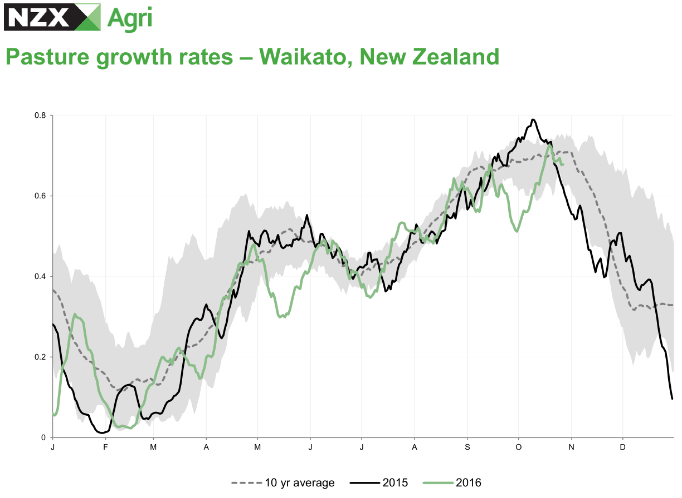

Slide 10
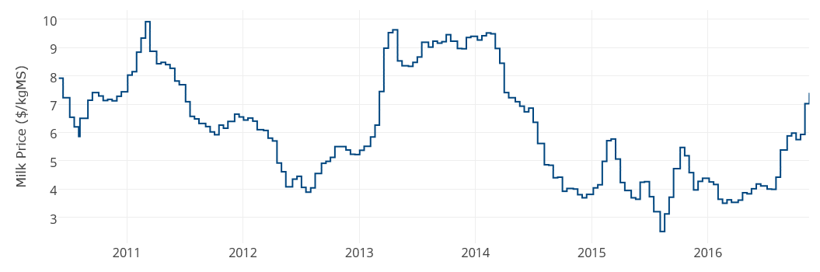
Price is Volatile

Slide 11
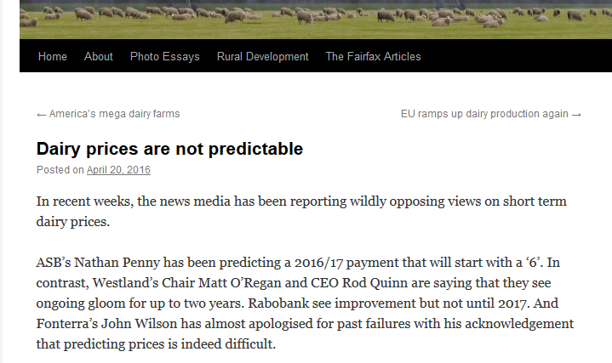
keithwoodford.wordpress.com

Slide 12
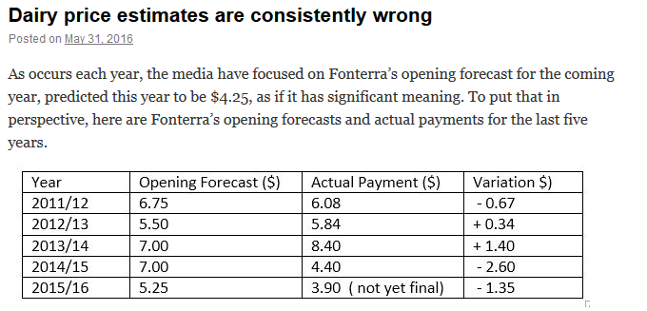
keithwoodford.wordpress.com

Slide 13
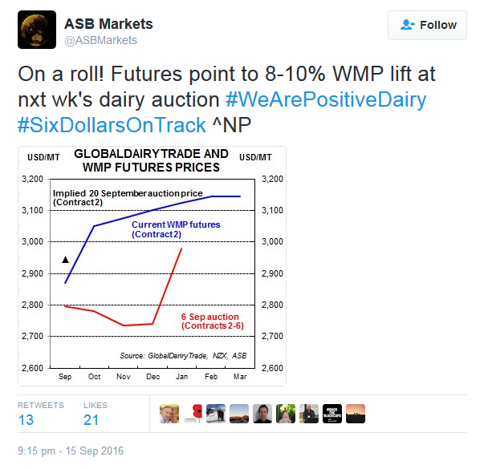
keithwoodford.wordpress.com

Slide 14
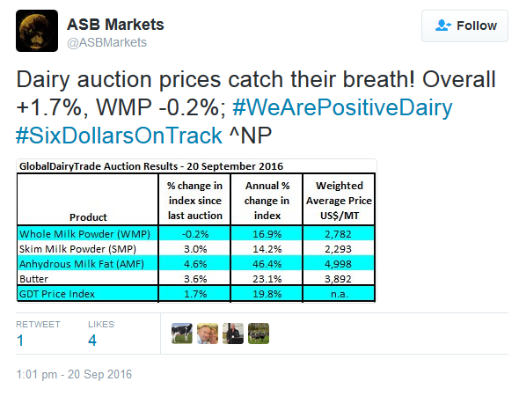
keithwoodford.wordpress.com

Slide 15
Stochastic Dual Dynamic Programming to the rescue!

Slide 16

Evaporation
Rainfall
Sunlight
Transpiration
Evaporation
potential
Temperature
Drainage

Slide 17
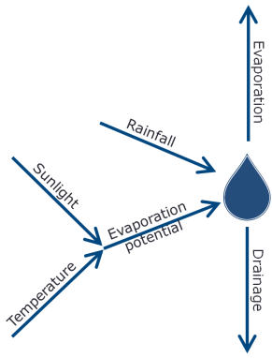

Growth
Fertiliser
Harvest
Transpiration
Feed
Nitrogen

Slide 18

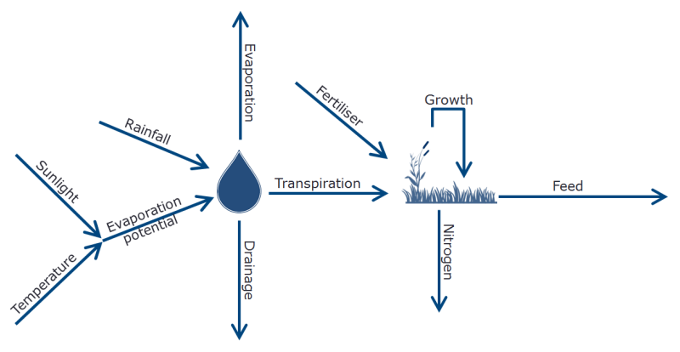
Buy
Harvest
Feed

Slide 19
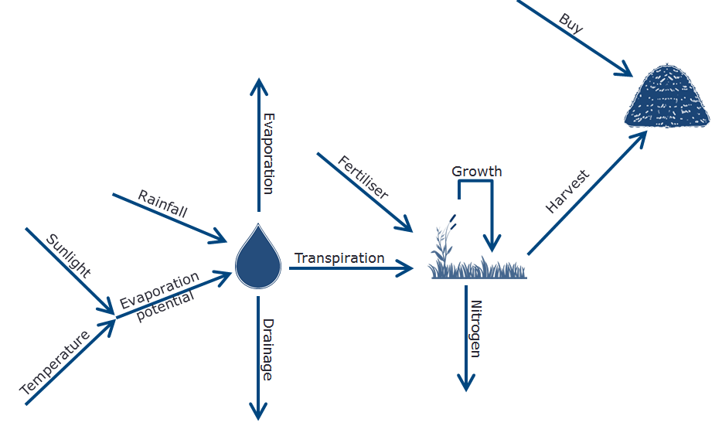

Feed
Feed
Feed
Feed
Dry
Milk
$
FGMP

Slide 20
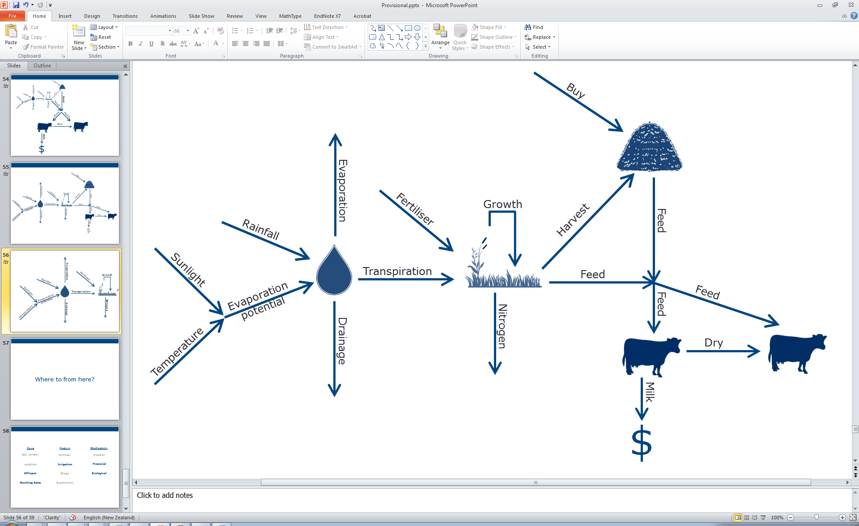
FGMP

Slide 21
NIWA
FGMP

Slide 22
Moir et al.
NIWA
FGMP

Slide 23
Moir et al.
NIWA
GDT
FGMP

Slide 24
Moir et al.
NIWA
DairyNZ
GDT
FGMP

Slide 25
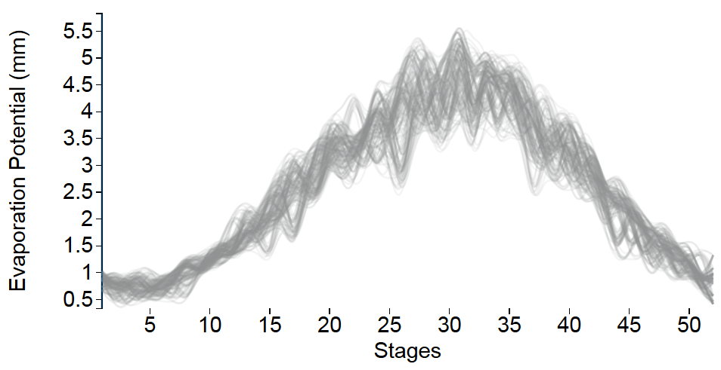
Evaporation Potential

Slide 26
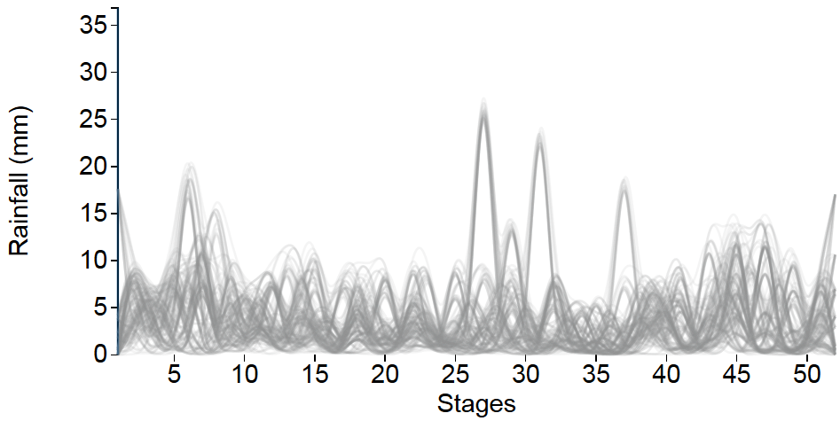
Rainfall

Slide 27
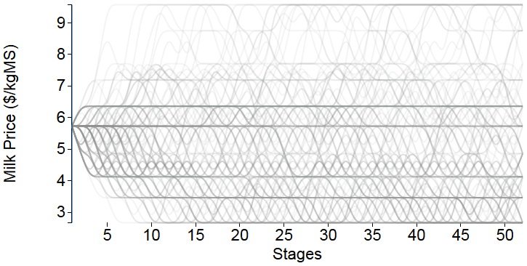
Milk Price

Slide 28
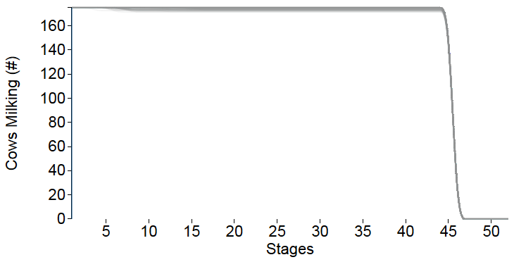
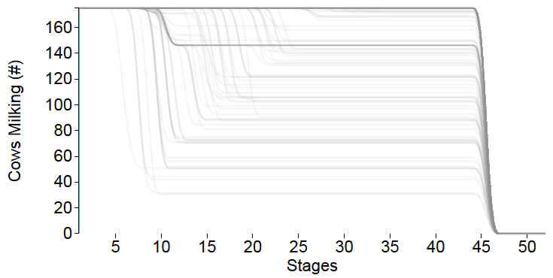
Dry off Decisions
Risk Neutral
Risk Averse

Slide 29
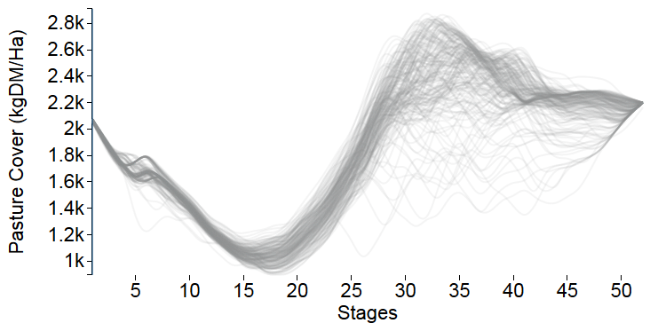
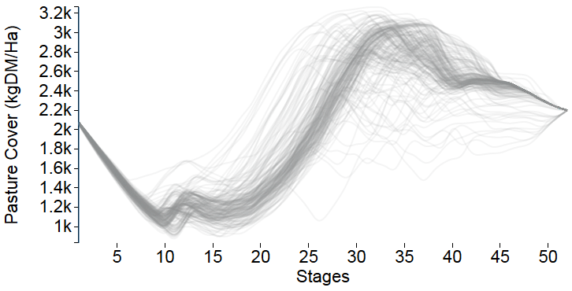
Pasture Management
Risk Neutral
Risk Averse

Slide 30
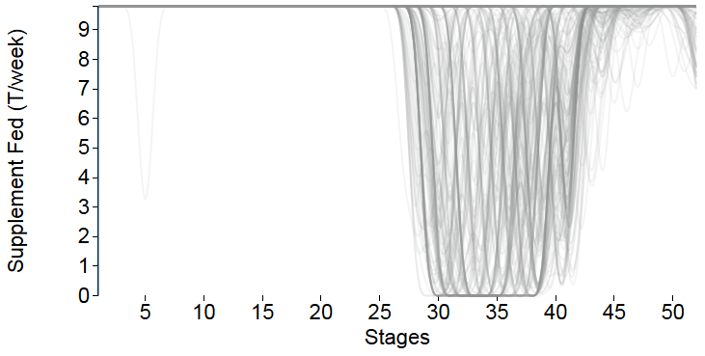
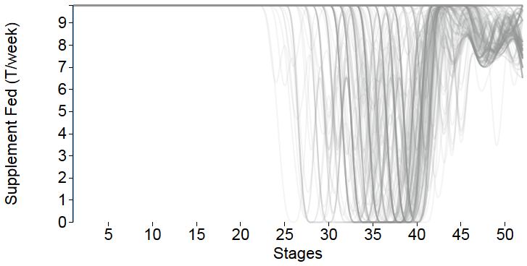
Supplementation
Risk Neutral
Risk Averse

Slide 31
Objective
Drying off cows early
Buying expensive
feed

Slide 32
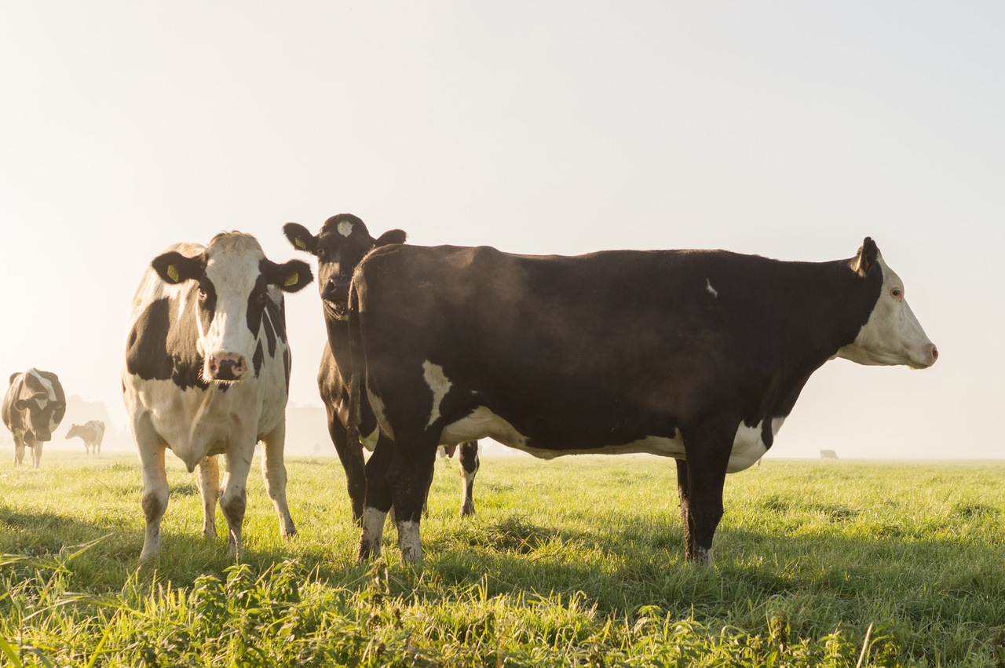

Slide 33
Help! An electricity related market design problem
Producers
Creates a random quantity of milk over time
Perishable product so all milk must be sold
Can store some as inventory
Can change product mix
Buyers
Have demand for different products
Want flexibility in contracting decisions
Can shift demand between time periods
What is the “fair market price” for the milk?
Producer
Large
Buyer
Small Buyer

